Slide 1






ASP.NET UI
Presented By :
Muhammad Atif Hussain
Head of I.T. (Takaful Pakistan Limited)
Technologies Consultant (AUC Technologies)
MCS(KU)
MSCS(SZABIST)
MCP
MCAD
MCSD
MCTS (Windows, Web, Distributed Applications)
MCPD (Enterprise Applications)
MCT(Microsoft Certified Trainer)

Slide 2
Agenda
ASP.NET Master Pages
ASP.NET Navigation Controls
ASP.NET Themes
ASP.NET Skin

Slide 3
Overview
What is Good UI?
  Not just visually appealing…
  Consistent, Accessible, Standards Compliant
  Modular/Interchangeable styles
  Time/Cost efficient
ASP.NET 2.0 Features and Usage
  Master Pages – Content and Layout of your Site
  Themes – Modify Appearances independently of Content
  Navigation – Menu, TreeView, SiteMapPath, and More
Approach
  Conceptual Stuff, Demos, then Recommendations
Notes:
© 2005 Microsoft Corporation. All rights reserved.
This presentation is for informational purposes only. Microsoft makes no warranties, express or implied, in this summary.

Slide 4
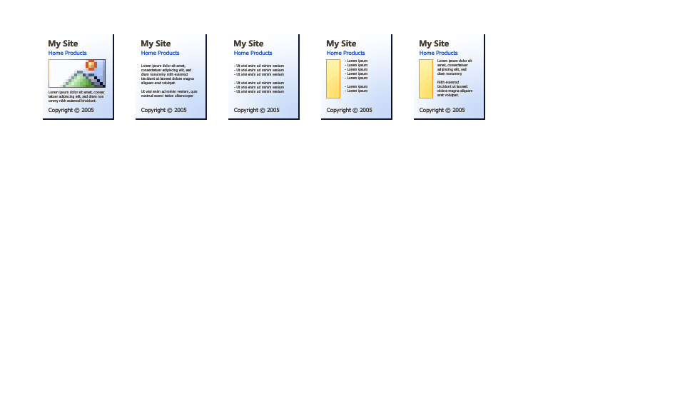
Master Pages - Current Situation
Hundreds of pages difficult to update
Layout is reused across site: header, footer, nav
Code and markup not reused = duplication
Current solutions:
  Include Files - unbalanced tags, many files
  User Controls - pages littered with controls, many files
  Tools-based solution – design-time only, commitment
Notes:
© 2005 Microsoft Corporation. All rights reserved.
This presentation is for informational purposes only. Microsoft makes no warranties, express or implied, in this summary.

Slide 5
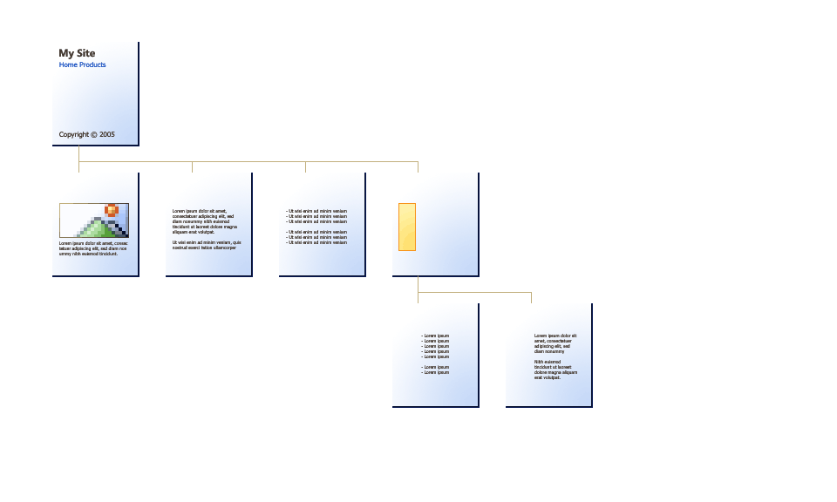

Master Pages - Introduction
Factor redundancies into reusable templates
Inheritance concept baked-in architecturally
Unlimited Nesting
Less Files, Controls
Balanced tags per file
Runtime merge
Notes:
© 2005 Microsoft Corporation. All rights reserved.
This presentation is for informational purposes only. Microsoft makes no warranties, express or implied, in this summary.

Slide 6

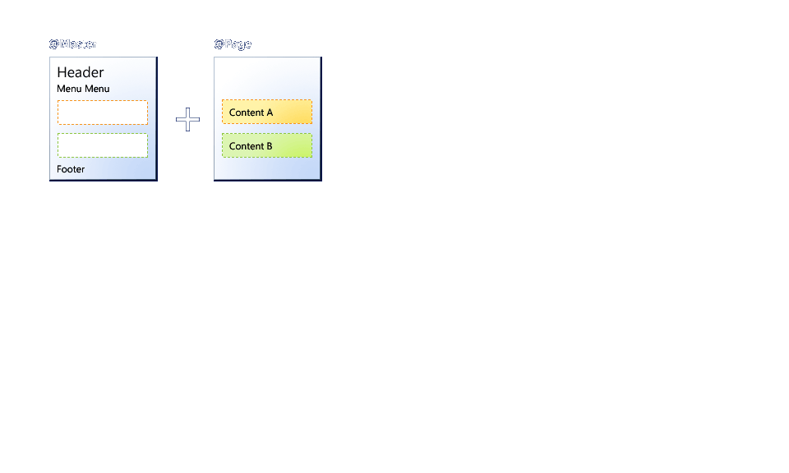
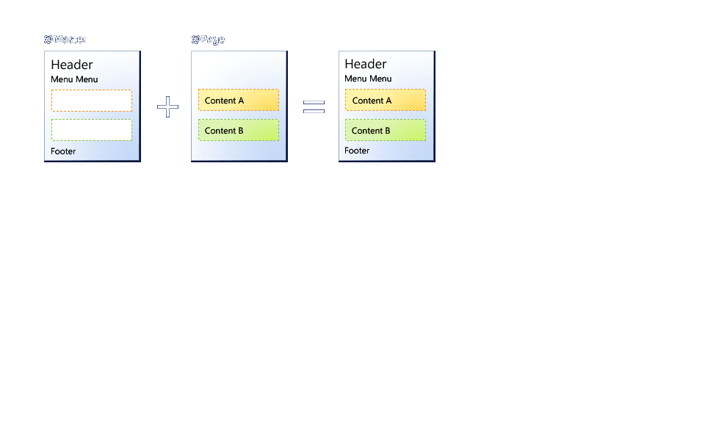
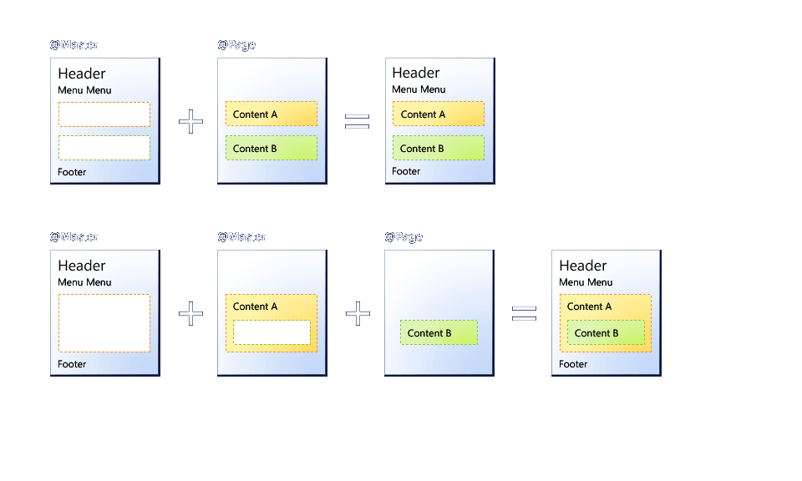
Master Pages - Content Pages
Notes:
© 2005 Microsoft Corporation. All rights reserved.
This presentation is for informational purposes only. Microsoft makes no warranties, express or implied, in this summary.

Slide 7
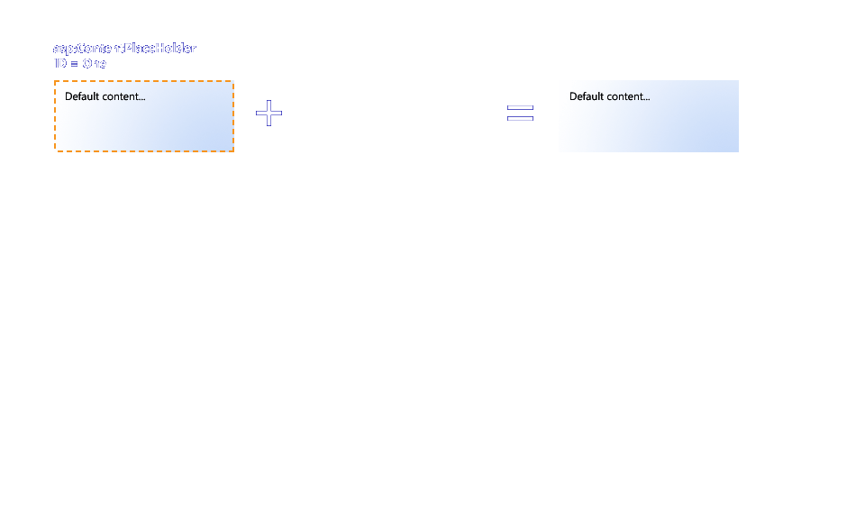
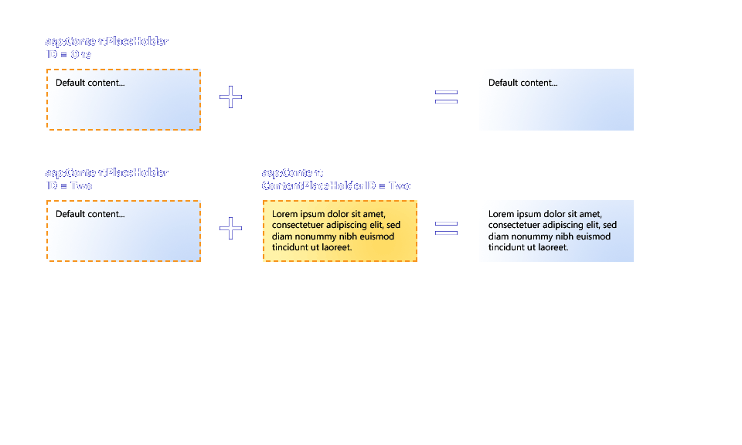
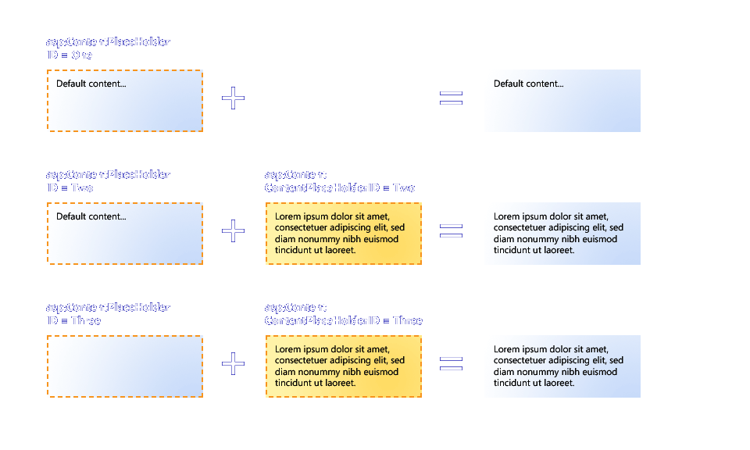
MP = ContentPlaceHolder + Content Controls
Notes:
© 2005 Microsoft Corporation. All rights reserved.
This presentation is for informational purposes only. Microsoft makes no warranties, express or implied, in this summary.

Slide 8
Master Pages - Basics
Masters define common content and placeholders (<asp:ContentPlaceHolder>)
Content pages reference masters and fill placeholders with content (<asp:Content>)
Site.master
default.aspx
http://.../default.aspx
<%@ Master %>
<asp:ContentPlaceHolder
ID="Main"
RunAt="server" />
<%@ Page MasterPage-
File="Site.master" %>
<asp:Content
ContentPlaceHolderID=
"Main" RunAt="server" />
</asp:Content>

Slide 9
Master Pages - Defining and Applying
Defining
<%@ Master %>
Applying
<%@ Page MasterPageFile="~/Site.master" %>
<asp:Content ContentPlaceHolderID="Main" RunAt="server">
This content fills the place holder "Main" defined in the master page
</asp:Content>

Slide 10

Master Pages
Applying to a site
<configuration>
<system.web>
<pages masterPageFile="~/Site.master" />
</system.web>
</configuration>
Applying Programmatically
Sub Page_PreInit (ByVal sender As Object,ByVal e As EventArgs)
Page.MasterPageFile = "~/Site.master"
End Sub

Slide 11
Master Pages - Weak Typing
In the master page…
<asp:Label ID="Title" RunAt="server" />
In the content page…
(CType(Master.FindControl ("Title"), Label).Text = "Orders"

Slide 12
Master Pages - Strong Typing
In the master page…
<asp:Label ID="Title" RunAt="server" />
.
.
.
<script language=“VB" runat="server">
Public Property TitleText as string
Get
return Title.Text
End Get
Set
Title.Text = value
End Set
End Property
</script>
In the content page…
Master.TitleText = "Orders"

Slide 13
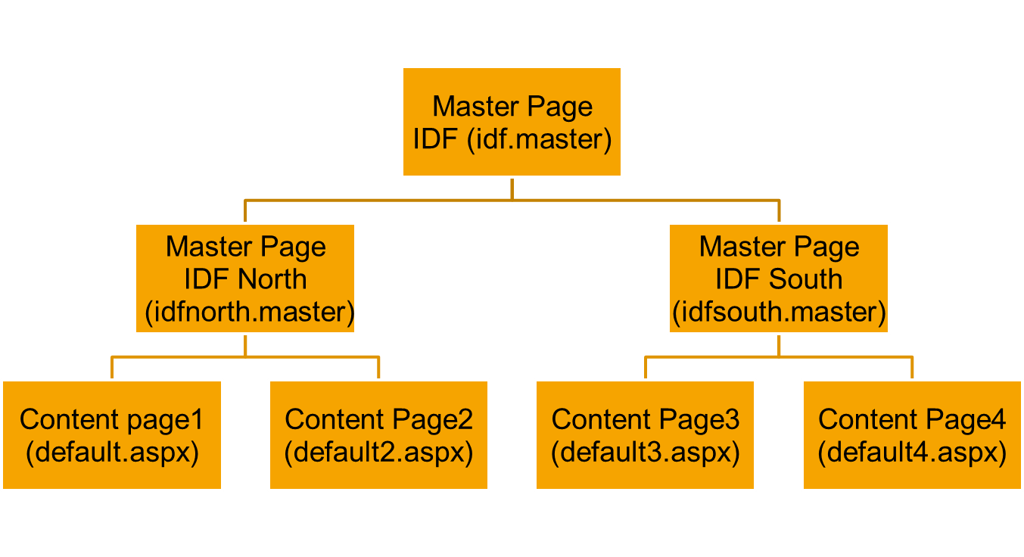
Master Pages - Nesting

Slide 14
Master Pages - Nesting (cont..)
Master pages that have masters must contain only Content controls, but Content controls can contain ContentPlaceHolders
<!-- Orders.Master -->
<%@ Master MasterPageFile="~/Site.Master" %>
<asp:Content ContentPlaceHolderID="..." RunAt="server">
<asp:ContentPlaceHolder ID="..." RunAt="server">
...
</asp:ContentPlaceHolder>
<asp:Content>

Slide 15
Master Pages - Container-Specific
<%@ Page Language=”VB” MasterPageFile=”~/Sela.master”
Mozilla:MasterPageFile=”~/SelaMozilla.master”
Opera:MasterPageFile=”~/SelaOpera.master” %>
<asp:Content ID=”Content1” ContentPlaceHolderId=”ContentPlaceHolder1”
Runat=”server”>
Hello World
</asp:Content>

Slide 16
Master Pages - Container-Specific
Master page child controls initialization
Content page child controls initialization
Master page initialization
Content page initialization
Content page load
Master page load
Master page child controls loadContent page child controls load

Slide 17
Master Pages - Advance Topics
Declaring the Master Page
  Per Page – Page Directive
  Per Application – Web.config
Programming against the Master Page model
  MasterPageType
  Dynamic Switching during PreInit
Rendering for Mobile
  mozilla:MasterPageFile = “~/Mozilla.master”
Visual Studio Support
Notes:
© 2005 Microsoft Corporation. All rights reserved.
This presentation is for informational purposes only. Microsoft makes no warranties, express or implied, in this summary.

Slide 18
Master Pages - Recommendation Usage
Working with a graphic designer
  No need to deliver ASPX, just HTML is fine
  Avoid (slightly) incongruent page designs
  Don’t cross the visual line between the master and content
Themes and Master Pages overlap:
  Change style sheet by changing Master Page
  Change layout by using CSS (Themes)
Make an exception for your front page
Notes:
© 2005 Microsoft Corporation. All rights reserved.
This presentation is for informational purposes only. Microsoft makes no warranties, express or implied, in this summary.

Slide 19
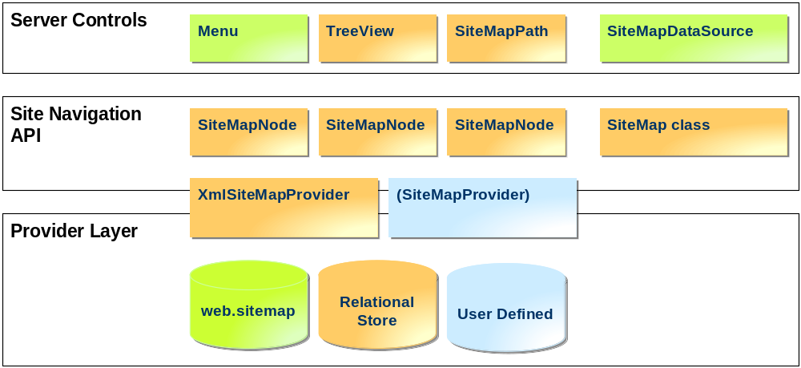
Navigation - Introduction
Notes:
© 2005 Microsoft Corporation. All rights reserved.
This presentation is for informational purposes only. Microsoft makes no warranties, express or implied, in this summary.

Slide 20
Navigation - Recommendation Usage
Not all designs are possible without templates or custom controls!
  Understand the intrinsic markup structure of each control
  Understand where you can specify CSSClass
Understand when to use Menu and TreeView
 | Menu | Treeview
Expansion | PopOut | Expand in Place
Checkboxes | No | Yes
Download on Demand | No | Yes
Templates | Yes | No
Layout | Horizontal & Vertical | Vertical
Notes:
© 2005 Microsoft Corporation. All rights reserved.
This presentation is for informational purposes only. Microsoft makes no warranties, express or implied, in this summary.

Slide 21
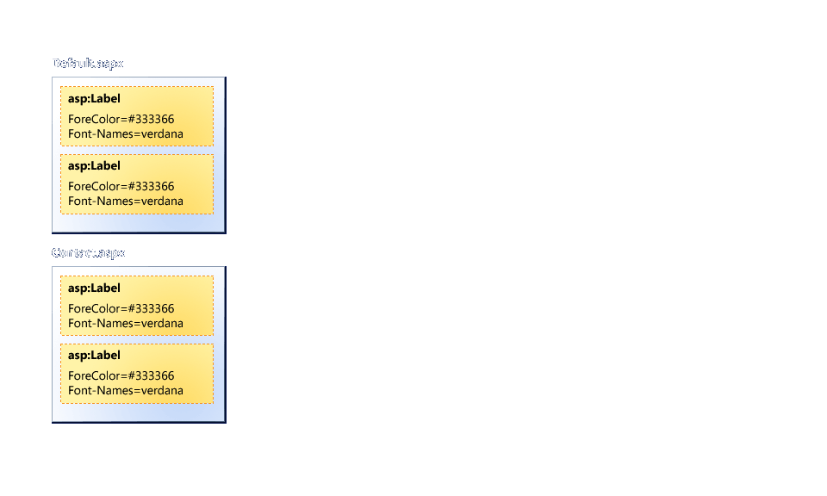
Themes - Current Situation
Notes:
© 2005 Microsoft Corporation. All rights reserved.
This presentation is for informational purposes only. Microsoft makes no warranties, express or implied, in this summary.

Slide 22
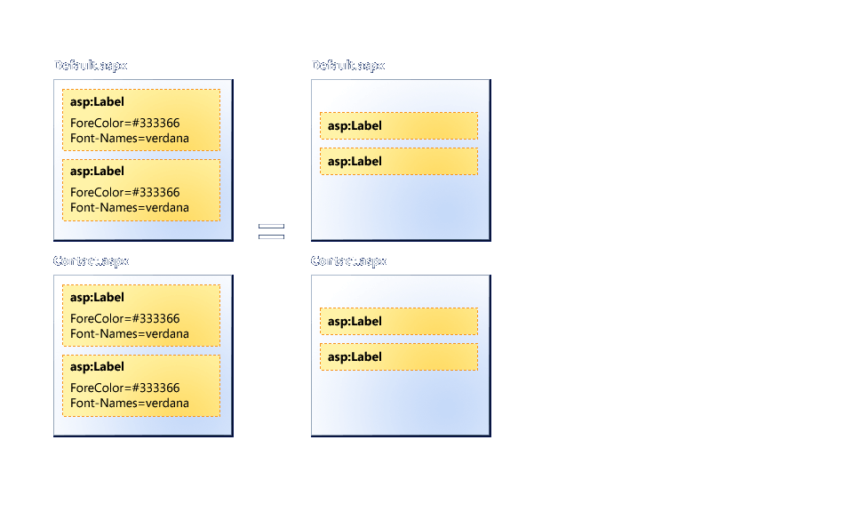
Themes - Introduction
Notes:
© 2005 Microsoft Corporation. All rights reserved.
This presentation is for informational purposes only. Microsoft makes no warranties, express or implied, in this summary.

Slide 23
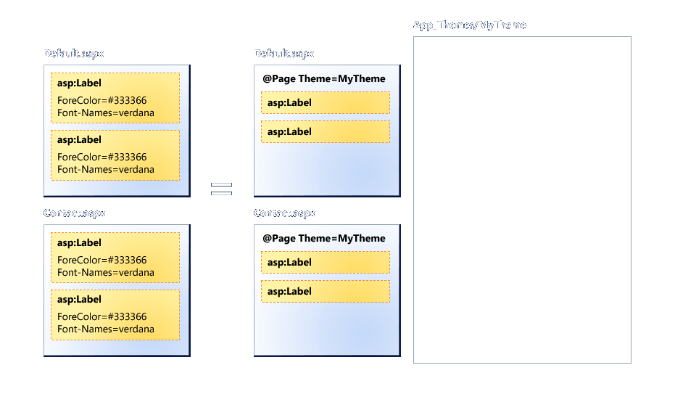
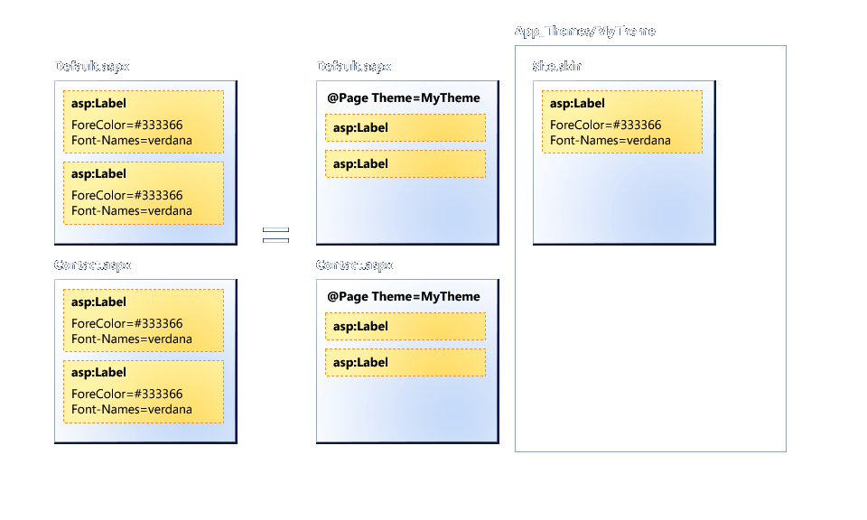
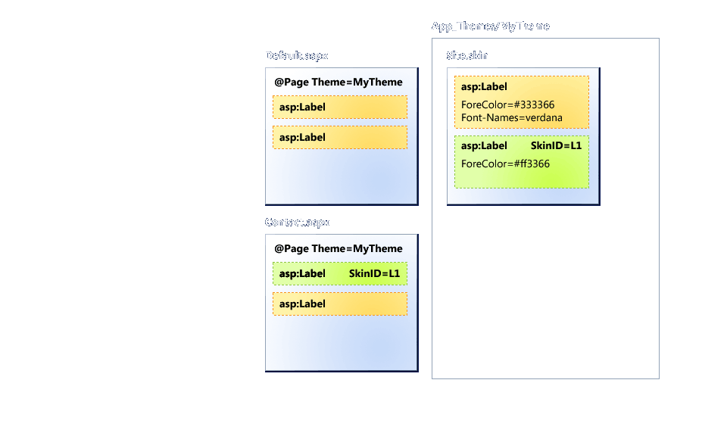
Theme Folders and Skin Files
Notes:
© 2005 Microsoft Corporation. All rights reserved.
This presentation is for informational purposes only. Microsoft makes no warranties, express or implied, in this summary.

Slide 24
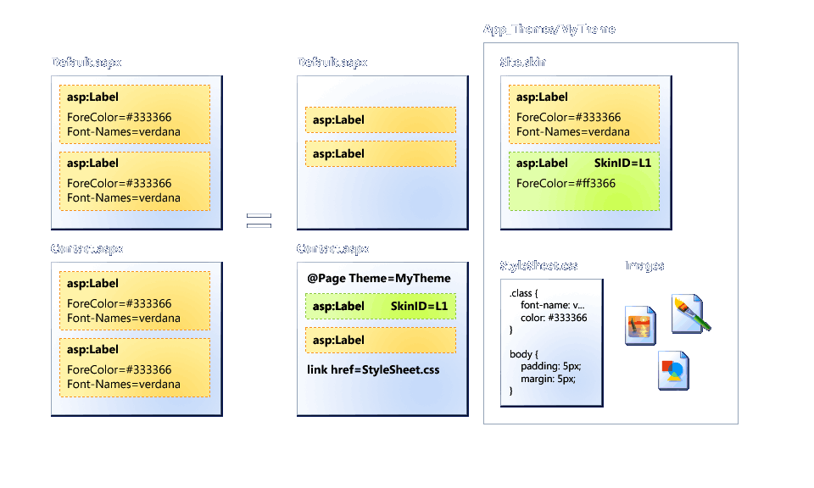
Themes - CSS and Image Files
Notes:
© 2005 Microsoft Corporation. All rights reserved.
This presentation is for informational purposes only. Microsoft makes no warranties, express or implied, in this summary.

Slide 25
Themes - Advance Scenario
Declaring the Theme
  Per Page – Page Directive
  Per Application – Web.config
Understanding the Page Lifecycle
  Dynamic Switching in PreInit
Used as both a pre-step and post-step operation:
  StyleSheetTheme – “Suggested” Look and Feel
  Theme – “Enforced” Look and Feel
Visual Studio Support
Notes:
© 2005 Microsoft Corporation. All rights reserved.
This presentation is for informational purposes only. Microsoft makes no warranties, express or implied, in this summary.

Slide 26
Themes
Priority:
Controls
Page level
Web.config

Slide 27
Themes
Stylesheet theme attributes
Theme | Stylesheet theme
Overridden the control properties like backcolor, forecolor | Not overridden

Slide 28
Themes - Skin
Create our own themes: (*.skin)
  In folder App_Themes create: summer, fall, winter, spring subfolders
  Each theme folder must contains:
    A single skin file
    A skin is a definition of style applied to server controls. It can work in conjunction with CSS files or image
    CSS file
    Skin just for server controls. CSS can applied to HTML server control
    Images: (creating image folder in theme folder)

Slide 29
Themes - Define Multiple Skin Option
Create multiple skin versions such as
<asp:textbox> with SkinID
Programmatically working with themes:
  Page.theme = Request.QueryTring[“themchange”];
  Textbox_name.SkinID = “SkinID_name”

Slide 30
Themes - Recommended Usage
Do as much as you can inside the Style Sheet
  When producing multiple themes, have your designer deliver multiple CSS files but only one XHTML file
  www.csszengarden.com is a great example
  Modify layout without changing your Master Page
When to use Skins:
  Foreground Images can’t be controlled by CSS
  Advanced controls, and collections
What does not belong in themes:
  Global Images
  Shared, Print, or Other Stylesheets
Notes:
© 2005 Microsoft Corporation. All rights reserved.
This presentation is for informational purposes only. Microsoft makes no warranties, express or implied, in this summary.

Slide 31
Summary - Managing the Complex UI
Master Pages
  Manage the “skeleton” of your site
  Manage the XHTML
Themes
  Manage the “skin” of your site.
  Manage the CSS.
Menu, Tree View, “Breadcrumbs”
  Tools to get around your site.
Notes:
© 2005 Microsoft Corporation. All rights reserved.
This presentation is for informational purposes only. Microsoft makes no warranties, express or implied, in this summary.

Slide 32


Slide 33
Questions
?

